Slide 1

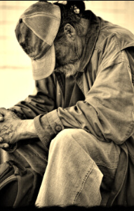
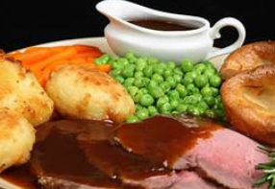
June 21st, 2025
12:00 – 2:00 PM
TWCC Coatesville
2025 Feeding
City Gates Mission/Shelter
17 N 7th Avenue
Coatesville, PA 19320

Slide 2
Donations Needed
Cases of Water
Paper Towels
Toilet Paper
Men Clothes & Sneakers (Various size-new or slightly used)
Men Socks
Toothpaste / Toothbrushes
Men Deodorant
Large Trash Bags
Napkins
Juices
Sodas
Snacks
We have 25 residents at the shelter who are in need of various items. Any donations you can provide would be greatly appreciated and we need enough food to feed around 50 - 60 individuals.

